Slide 1

Chemistry: CHEM 201TH
CARBOHYDRATES
Department of Chemistry
Government College
Paonta Sahib (HP)

Slide 2
Today’s Topics
RING STRUCTURE OF D-(-)-FRUCTOSE
Limitations of the Open Chain Structure of Fructose
Pyranose Structure of D-(-)-Fructose
Ring Size of D-(-)-Fructose
Haworth Projection Formulae

Slide 3
Limitations of the Open Chain Structure of Fructose
The open chain structure of fructose accounts for most of its properties but fails to explain the following facts:
D-Fructose does not react with sodium bisulphite even though it contains a ketonic group.
It exists in two stereoisomeric farms, i.e., α-D-(-)-fructose and β-D-(-)-fructose which show mutarotation.
It forms two stereoisomeric methyl fructosides on treatment with methanol and dry HCl gas.

Slide 4
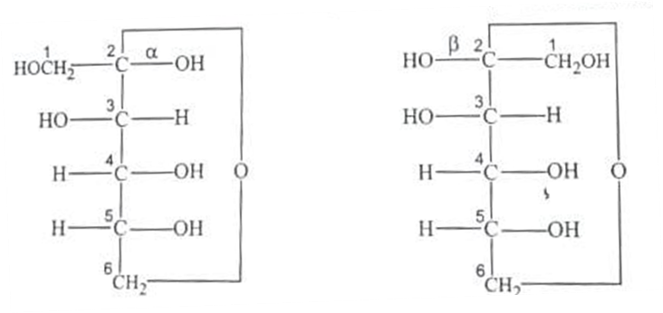
Pyranose Structure of D-(-)-Fructose
To explain limitations of open chain structure and certain other facts of D-fructose, it was suggested that fructose exists in a cyclic hemiketal structure. It was assigned a six-membered hemiketal or pyranose structure which is formed by combination of ketonic group at C-2 and hydroxyl group at C-6 to give rise to α- and β-D-fructose as shown below

Slide 5
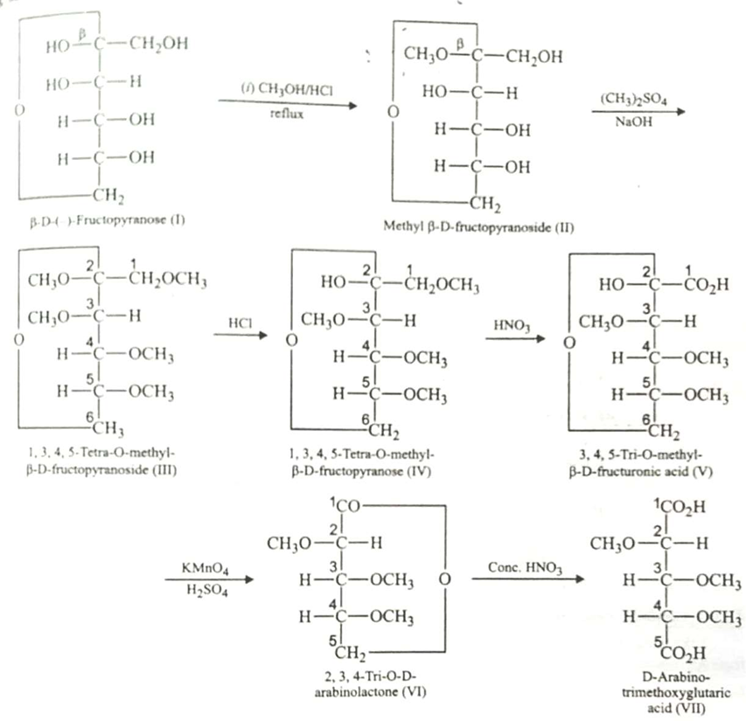
Ring Size of D-(-)-Fructose
The procedure used for determining the ring size of fructose was similar to that in case of glucose, but fructose derivative (IV) is first oxidised with dil. HNO₃ and then with KMnO₄. By doing so Iactone (VI) is obtained which upon oxidation with moderately conc. HNO₃ gave D-arabinotrimethylglutartc acid. This confirmed six-membered or pyranose ring of fructose.

Slide 7
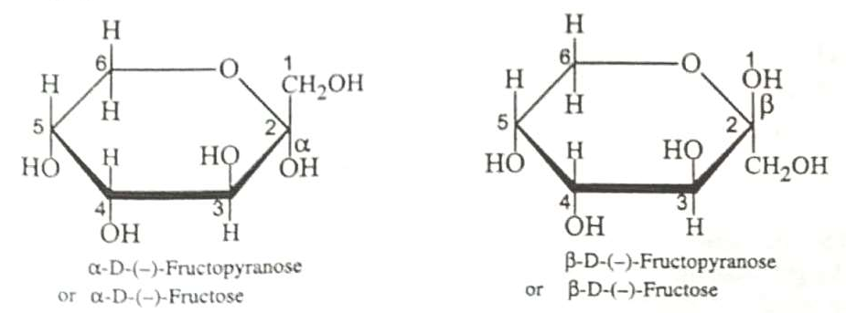
Haworth Projection Formulae
The Haworth projection formulae of α- and β-D-fructopyranose may be represented as follows

Slide 8
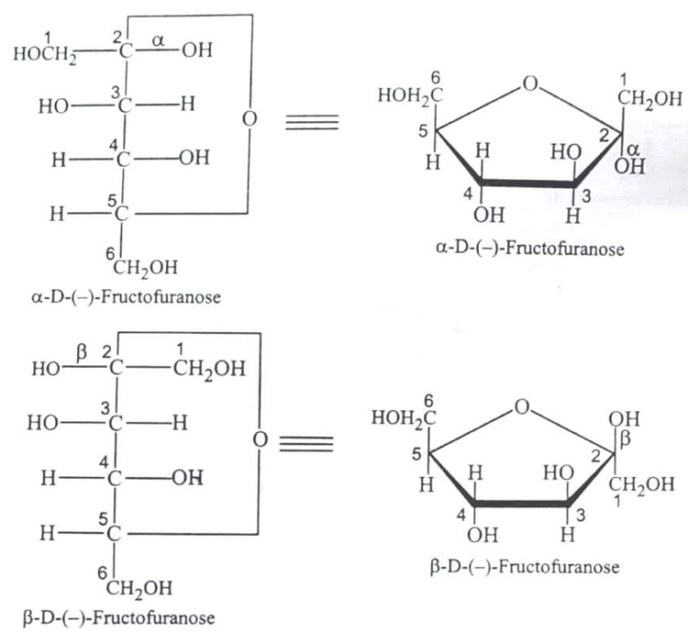
Furanose Structure of D-(-)-Fructose
Although in the free state fructose has the six-membered cyclic or the pyranose structure but in the combined state such as in fructosides, disaccharides like sucrose, etc., fructose always has the five-membered cyclic ring structure or the furanose structure. The Fischer and Haworth projection formulae for α- and β-D-fructofuranose are given below

Slide 9
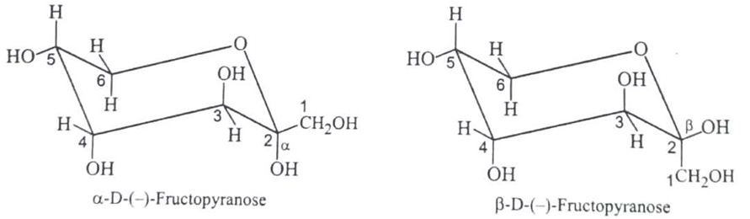
Conformations of α- and β-D-(-)-Fructose
Like glucose, fructose also exists in the chair conformation. The chair conformations of α- and β-D-(-)-Fructoses are given below

Slide 10
Next Lecture
Structure of Disaccharides
Sucrose
Maltose
Lactose

Slide 11
Thank You

